Slide 1
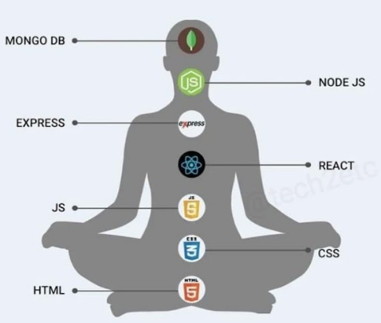


22CAC09N
FULL STACK DEVELOPMENT

Slide 2
ABOUT IMAGE
MERN is a popular Full Stack Web Development stack consisting of four technologies:
M → MongoDB E → Express.js R → React.js N → Node.js

Slide 3
Layer | Technology | Purpose
Head | MongoDB | Stores application data in a NoSQL database using JSON-like documents.
Neck | Node.js | Server-side runtime environment that executes JavaScript code.
Chest | Express.js | Backend web framework for handling routes, APIs, and server logic.
Center | React | Frontend library used to build interactive user interfaces.
Arm | JavaScript (JS) | Programming language used throughout the stack.
Lower Body | CSS | Styles the web pages and controls appearance.
Base | HTML | Defines the structure and content of web pages.

Slide 4
User
↓
React (Frontend/UI)
↓
Express.js (API Routes)
↓
Node.js (Server Runtime)
↓
MongoDB (Database)
How They Work Together
HTML creates the webpage structure.
CSS styles the webpage.
JavaScript adds interactivity.
React builds dynamic frontend user interfaces.
Express.js handles API requests on the server.
Node.js runs the backend JavaScript code.
MongoDB stores and retrieves data.

Slide 5
COURSE OUTCOMES
Design responsive web pages using HTML, CSS, and Bootstrap.
Develop interactive client-side features using JavaScript and AJAX.
Build single-page applications with React and its core features.
Create backend services using Node.js and Express.js.
Perform CRUD operations and schema design using MongoDB.

Slide 6
22CAC09N -FULL STACK DEVELOPMENT
Full Stack Development:
It refers to the development of both front end(client side) and back end(server side) portions of web application.
Full Stack Web Developers:
A full stack developer is one who is comfortable working with both backend and frontend technologies.

Slide 7
22CAC09-FULL STACK DEVELOPMENT
UNIT-I
Introduction to Full StAck Development: HTML 5.0
Introduction to basic HTML tags, HTML DOM, Working with Images, Tables, Lists, Forms, Layout elements, Usage of span and div tags for layout structuring
Introduction to Cascading Style Sheets:
Types of CSS (Inline, Internal, External), CSS Selectors, CSS BOX Model. Bootstrap 5:
Introduction to Bootstrap framework, usage of container and container-fluid classes, grid system, UI components such as carousel, buttons, tables, forms, alerts, images, tabs/pills, navbar, and modals.

Slide 8
22CAC09-FULL STACK DEVELOPMENT
UNIT-II
Java Script: Data types and type conversion, handling events. Object-Oriented Programming in JavaScript, use of regular expressions.
Ajax: Introduction to AJAX, working with XMLHttpRequest and the Fetch API, JSON data,sending and receiving JSON data asynchronously, and handling server responses in the browser.

Slide 9
22CAC09-FULL STACK DEVELOPMENT
UNIT-III
React JS: Introduction to React JS, using JSX syntax, comparison of actual DOM vs React’s Virtual DOM (VDOM). Creating and managing functional components, understanding state and props, handling events, useState and useEffect hooks,React Router, Handling user inputs with controlled forms and form validation
Angular : Introduction to Angular and Angular CLI, creating and managing Angular components and templates. Data binding: property binding and event binding.

Slide 10
22CAC09-FULL STACK DEVELOPMENT
UNIT- IV
Node JS Modules: Introduction to Node.js and the Node Package Manager (npm). Working with Node.js modules, creating a basic web server, and understanding the request-response cycle. Working with the file system to read and write files asynchronously.
Introduction to Event Driven Architecture: EventEmitter class, creating custom events, and extending the EventEmitter class. Handling common I/O operations and implementing basic

Slide 11
22CAC09-FULL STACK DEVELOPMENT
UNIT-V
Express.js: Introduction to the Express.js framework for server-side application development. Routing and handling GET and POST requests, middleware functions, creating and using custom middleware, and serving static files. Using templating engines like EJS or Pug for dynamic content rendering.
MongoDB: Introduction to NoSQL databases, comparison of JSON and BSON data formats, working with MongoDB data types. CRUD operations (Create, Read, Update, Delete), schema design.

Slide 12
22CAC09-FULL STACK DEVELOPMENT
Text Books:
1.Jon Duckett, “HTML and CSS: Design and Build Websites”, Wiley India, 1st Edition, 2011.
2. Eric Freeman, “Head First HTML and CSS”, O'Reilly Media, 2nd Edition, 2012.
3. Ethan Brown, “Web Development with Node and Express”, O'Reilly Media, 1st Edition, 2014.
4. Brad Traversy, “Modern JavaScript From The Beginning”, Traversy Media, Online Course/Edition, 2020.
Online Resources:
MDN Web Docs: https://developer.mozilla.org/
W3Schools: https://www.w3schools.com/
React Official Docs: https://reactjs.org/
Angular Official Docs: https://angular.io/
Node.js Official Site: https://nodejs.org/
Express.js Docs: https://expressjs.com/
MongoDB Manual: https://docs.mongodb.co

Slide 13
22CAC09-FULL STACK DEVELOPMENT
Full Stack Development:
It refers to the development of both front end(client side) and back end(server side) portions of web application.
Full Stack Web Developers:
A full stack developer is one who is comfortable working with both backend and frontend technologies.

Slide 14



22CAC09-FULL STACK DEVELOPMENT
POPULAR TECH STACKS
MERN -MongoDB - ExpressJS - ReactJS -NodeJS
MEAN -MongoDB - ExpressJS - AngularJS -NodeJS
MEVN -MongoDB - ExpressJS - VueJS -NodeJS

Slide 15
FULL STACK DEVELOPER
Stage 1: HTML
Stage 2: CSS
Stage 3: JavaScript
Stage 4: ReactJs
Stage 5: NodeJs
Stage 6: ExpressJS
Stage 7: MongoDB

Slide 16
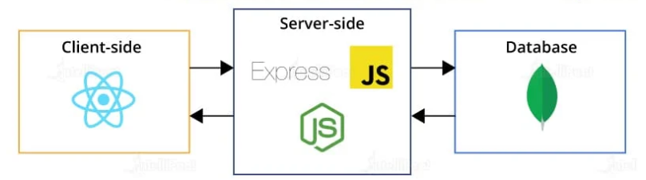
22CAC09-FULL STACK DEVELOPMENT
3- Tier Architecture of MERN Stack

Slide 17
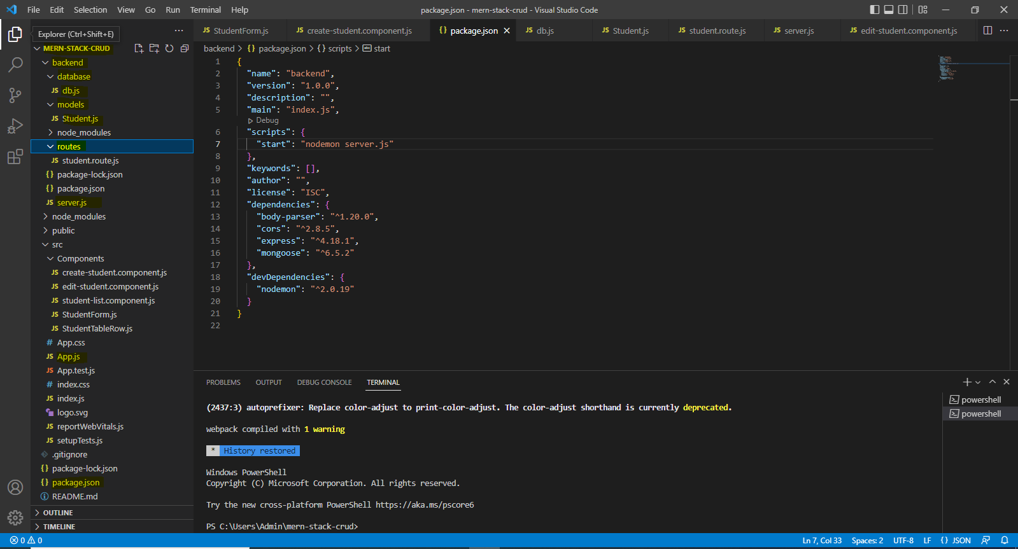
22CAC09-FULL STACK DEVELOPMENT
IDE’S Required for FSD-VS Code

Slide 18
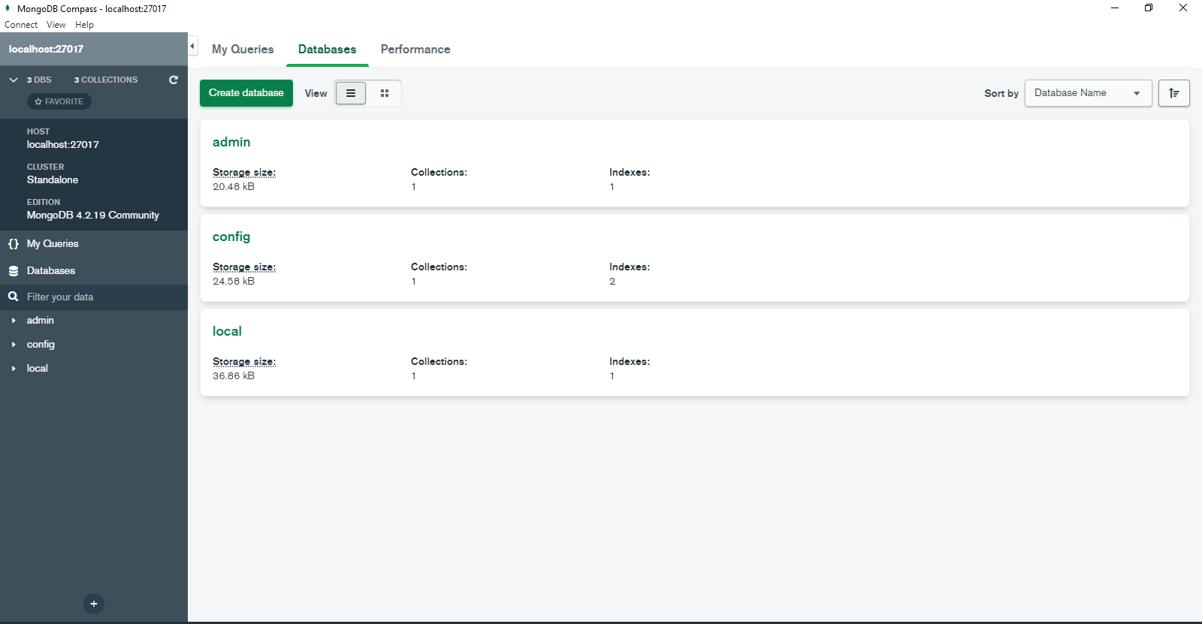
22CAC09-FULL STACK DEVELOPMENT
IDE’S Required for FSD-MongoDB Compass

Slide 19
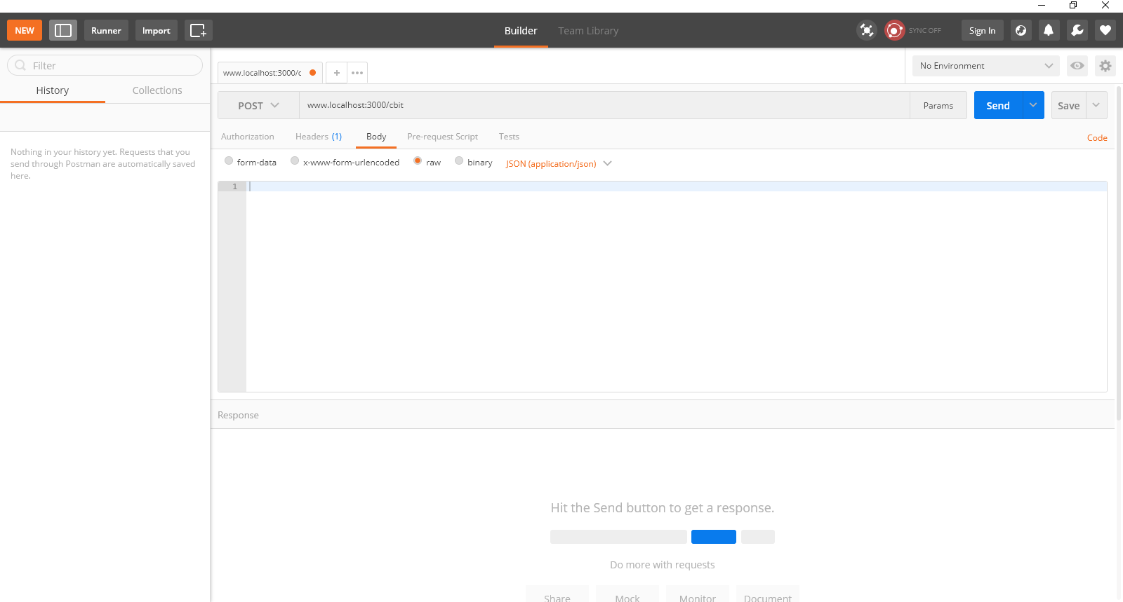
22CAC09-FULL STACK DEVELOPMENT
IDE’S Required for FSD-Postman

Slide 20
7 CHAKRAS OF MERN STACK DEVELOPER

Slide 21
Introduction: Web Fundamentals
U.S. Department of Defense(DoD) interested in developing a new large-scale computer network in the 1960’s, which led to ARPAnet (Advanced Research Projects Agency net).
Later in 1970’s and 1980’s BITNET(Because It’s Time Network) and CSNET(Computer Science Network) were developed for servicing the institutions of the Universities.
In 1986 NSFnet (National Science Foundation) was created and replaced ARPAnet for non-military uses.

Slide 22
Introduction: Web Fundamentals
By 1992, a wide variety of organizations had established nodes on this network and had connected more than 1 million computers around the world.
In 1995 a small part of NSFnet returned to being a research network and the rest became as Internet.

Slide 23
What The Internet Is?
The internet is a huge collection of computers connected in a communication network.
Transmission Control Protocol/Internet Protocol (TCP/IP), became the standard for computer network connections in 1982.
It can be used directly to allow a program on one computer to communicate with a program on another computer via the Internet.

Slide 24
What The Internet Is?
Rather than connecting every computer on the Internet directly to every other computer on the Internet, normally the individual computers in an organization are connected to each other in a local network. (LAN)
One node on this local network is physically connected to the Internet. So, the Internet is actually a network of networks rather than a network of computers.

Slide 25
Internet-Based Services
Email − A fast, easy, and inexpensive way to communicate with other Internet users around the world.
Telnet − Allows a user to log into a remote computer as though it were a local system.
FTP − Allows a user to transfer virtually every kind of file that can be stored on a computer from one Internet-connected computer to another.
UseNet news − A distributed bulletin board that offers a combination news and discussion service on thousands of topics.
World Wide Web (WWW) − A hypertext interface to Internet information resources.

Slide 26
Internet Protocol Address
Internet nodes are identified by numeric addresses.
The Internet Protocol (IP) address of a machine connected to the Internet is a unique 32-bit number.
IP addresses usually are written (and thought of) as four 8-bit numbers, separated by periods.
The four parts are separately used by Internet-routing computers to decide where a message must go next to get to its destination.

Slide 27
Internet Protocol Address
Class | Address Range | Supports
Class A | 0.0.0.0 to 127.255.255.254 | Supports 16 million hosts on each of 127 networks.
Class B | 128.1.0.1 to 191.255.255.254 | Supports 65,000 hosts on each of 16,000 networks.
Class C | 192.0.1.1 to 223.255.254.254 | Supports 254 hosts on each of 2 million networks.
Class D | 224.0.0.0 to 239.255.255.255 | Reserved for Multicast Groups.
Class E | 240.0.0.0 to 254.255.255.254 | Reserved for future use, or Research and Development Purposes.

Slide 28
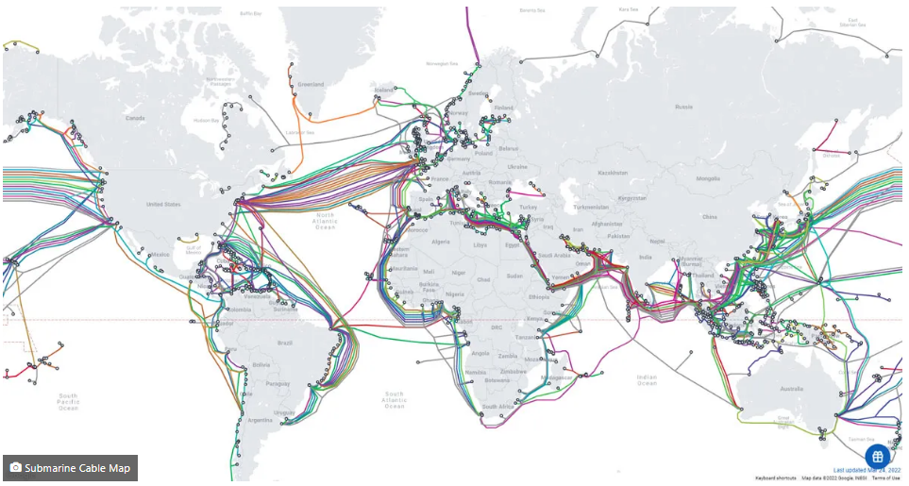
Submarine Cable World Map

Slide 29
Domain Names
Because people have difficulty dealing with and remembering numbers, machines on the Internet also have textual names.
https://www.cbit.ac.in/department-of-information-technology/
Protocol Subdomains Domain Name Top Level Domain File Path
The host name along with the domain names are together called a fully qualified domain name.
These domain names are converted into IP addresses by Domain Name System(DNS)

Slide 30
Domain Name System (DNS)
IP addresses are the addresses used internally by the Internet, But FQDN which is given by a browser user, must be converted to an IP address before the message can be transmitted over the Internet to the destination.
These conversions are done by software systems called name servers, which implement the Domain Name System (DNS).

Slide 31
Domain Name System (DNS)
Name servers serve a collection of machines on the Internet and are operated by organizations that are responsible for the part of the Internet to which those machines are connected.
All document requests from browsers are routed to the nearest name server.
If the name server can convert the fully qualified domain name to an IP address, it does so.
If it cannot, the name server sends the fully qualified domain name to another name server for conversion.
Like IP addresses, fully qualified domain names must be unique.

Slide 32
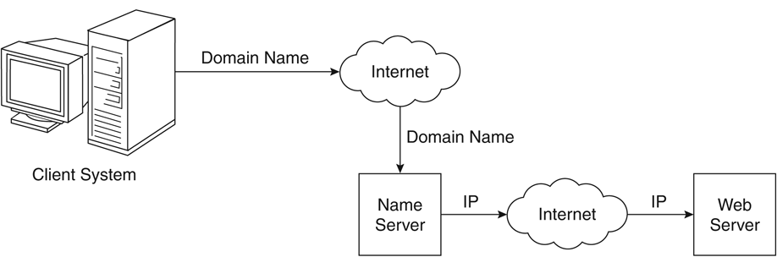
Domain Name Conversion
3.111.165.12

Slide 33
World Wide Web
In 1989, a small group of people led by Tim Berners-Lee at CERN (Conseil Européen pour la Recherche Nucléaire, or European Organization for Particle Physics),proposed a new protocol for the Internet, as well as a system of document access to use it.
The intent of this new system, which the group named the World Wide Web, was to allow scientists around the world to use the Internet to exchange documents describing their work.

Slide 34
Web or Internet?
The Internet is a collection of computers and other devices connected by equipment that allows them to communicate with each other.
The World Wide Web -- also known as the web, WWW or W3 -- refers to all the public websites or pages that users can access on their local computers and other devices through the internet.

Slide 35
Web Browser and Web Server
A browser is a client on the Web because it initiates the communication with a server, which waits for a request from the client.
Web servers are programs that provide documents to requesting browsers.
Servers are slave programs: They act only when requests are made to them by browsers running on other computers on the Internet.
The most commonly used Web servers are Apache, which has been implemented for a variety of computer platforms, and Microsoft’s Internet Information Server(IIS), which runs under Windows operating systems.

Slide 36
Web Server Operation
Web browsers initiate network communications with servers by sending them URLs
A URL can specify one of two different things:
1. The address of a data file stored on the server that is to be sent to the client. or
2. A program stored on the server that the client wants executed, with the output of the program returned to the client.
All the communications between a Web client and a Web server use the standard Web protocol, Hypertext Transfer Protocol (HTTP).

Slide 37
Web Server Operation
The primary task of a Web server is to monitor a communications port on its host machine, accept HTTP commands through that port, and perform the operations specified by the commands.
All HTTP commands include a URL, which includes the specification of a host server machine.
When the URL is received, it is translated into either a file name (in which case the file is returned to the requesting client) or a program name (in which case the program is run and its output is sent to the requesting client).

Slide 38
Uniform Resource Locators
Uniform (or universal) resource locators (URLs) are used to identify documents (resources) on the Internet.
scheme:object-address
In the case of HTTP, the form of the object address of a URL is as follows:
//fully-qualified-domain-name/path-to-document
When file is the protocol, the fully qualified domain name is omitted, making the form of such URLs as follows:
file://path-to-document

Slide 39
Multipurpose Internet Mail Extensions(MIME)
A browser needs some way of determining the format of a document it receives from a Web ser -/-n5uiover.
The forms of these documents are specified with Multipurpose Internet Mail Extensions (MIME).
MIME specifications have the following form:
type/subtype

Slide 40
Hyper Text Transfer Protocol(HTTP)
All Web communications transactions use the same protocol:
Hypertext Transfer Protocol (HTTP) formally defined as RFC 2616
HTTP consists of two phases:
Request and Response.
Each HTTP communication (request or response) between a browser and a Web server consists of two parts:
Header and a Body.
The header contains information about the communication; the body contains the data of the communication if there is any.

Slide 41
The Request Phase
The general form of an HTTP request is as follows:
1. HTTP method Domain part of the URL HTTP version
2. Header fields
3. Blank line
4. Message body
The following is an example of the first line of an HTTP request:
GET /storefront.html HTTP/1.1

Slide 42
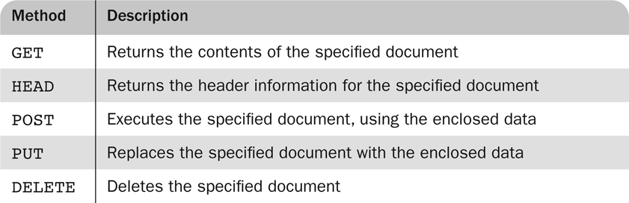
HTTP REQUEST METHODS
There are four categories of header fields:
1. General: For general information, such as the date.
2. Request: Included in request headers.
3. Response: For response headers.
4. Entity: Used in both request and response headers.

Slide 43
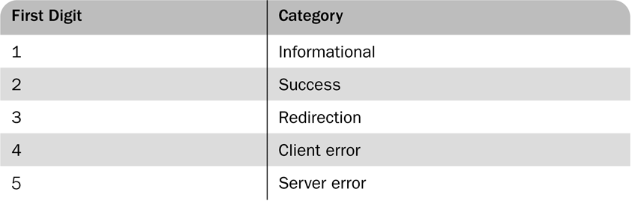
The Response Phase
The general form of an HTTP response is as follows:
1. Status line
2. Response header fields
3. Blank line
4. Response body
The status line includes the HTTP version used, a three-digit status code for the response, and a short textual explanation of the status code.
HTTP/1.1 200 OK
The status codes begin with 1, 2, 3, 4, or 5.

